Slide 1
Cat Feeder
Janik Abdullayev & Owen Moogk

Slide 2
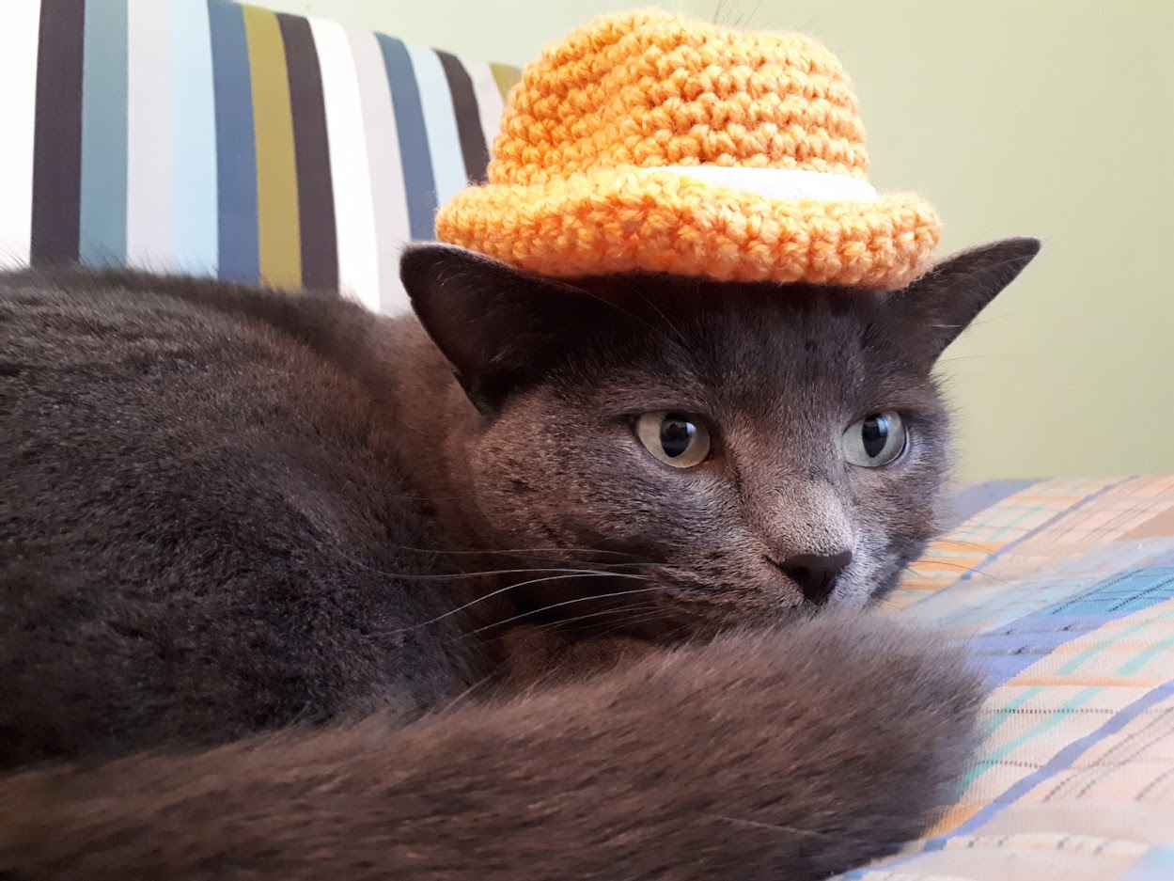
Why?
Janik owns a cat. (Named Masha, she’s very cute)
Janik has school from 8 till 2.
Janik then goes to work.
Janik does not want his cat to suffer due to his poor time management.
Overweight cats is an increasingly large issue in north america (30-35% obese)
Why a make a Cat Feeder?

Slide 3
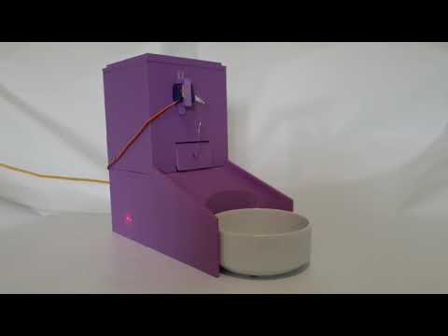
Introducing the
Cat Feeder
Made for JAMHacksV

Slide 4
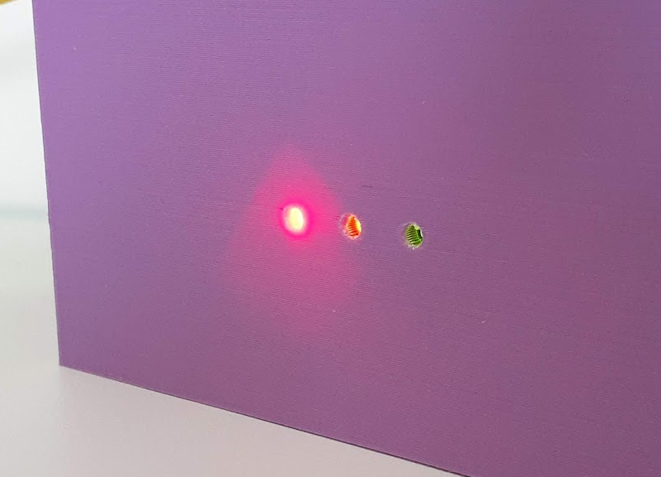
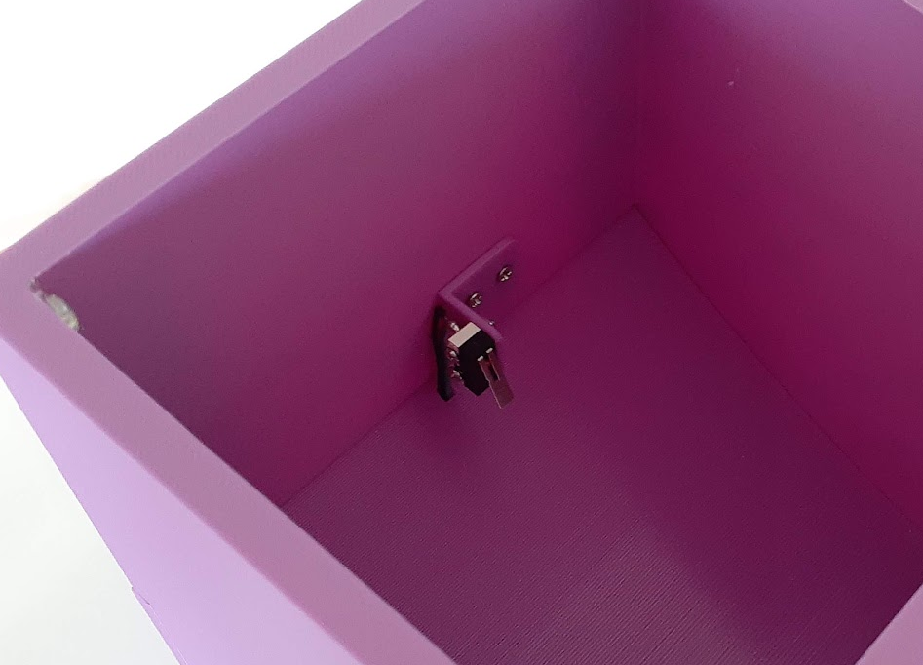
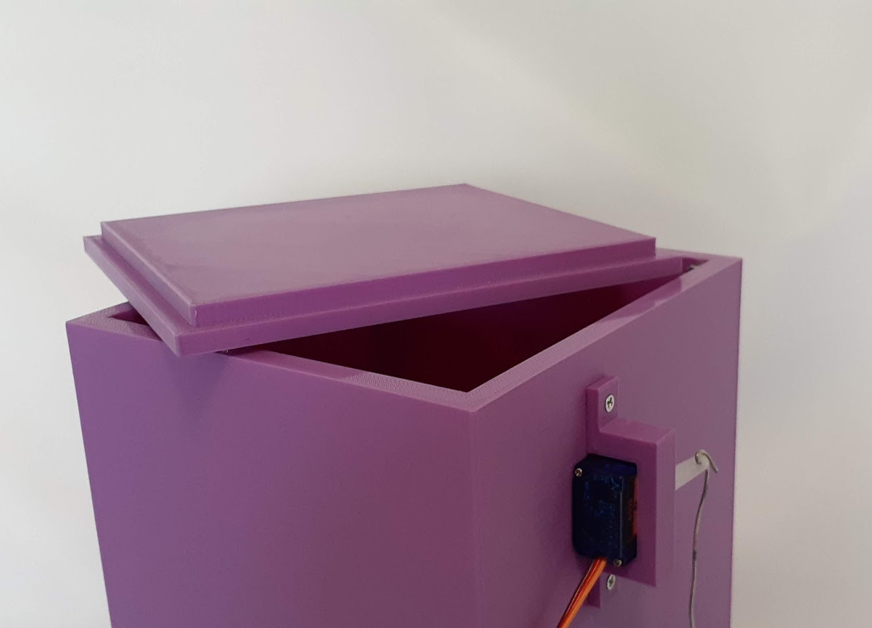
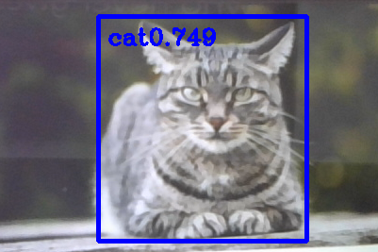
Presenting Revolutionary Features
Low Food Detection with Email Capability
LEDs for Easy Understanding
Automatic Cat Detection
Large & Easy Refill

Slide 5
How?
Three times a day, it is feeding time.
During that time, a Python OpenCV script runs in search of a cat.
When a cat is seen, a signal is sent from the Python script to the Arduino to open the food gate.
Anytime the Arduino senses low food, a signal is sent to the Python Script which sends an Email.
How Does it Work?

Slide 6
Technologies Used
OpenCV is the library used to perform computer vision and processing to detect a cat.
It gets the input frame by frame from the webcam
Detects objects in the image using OpenCV’s Deep Neural Network Detection Model
SMPTLib is an automated email python package.
It sends the email to Janik, letting him know that Masha needs more food.
Arduino Uno for motor controlling and onboard processing.

Slide 7
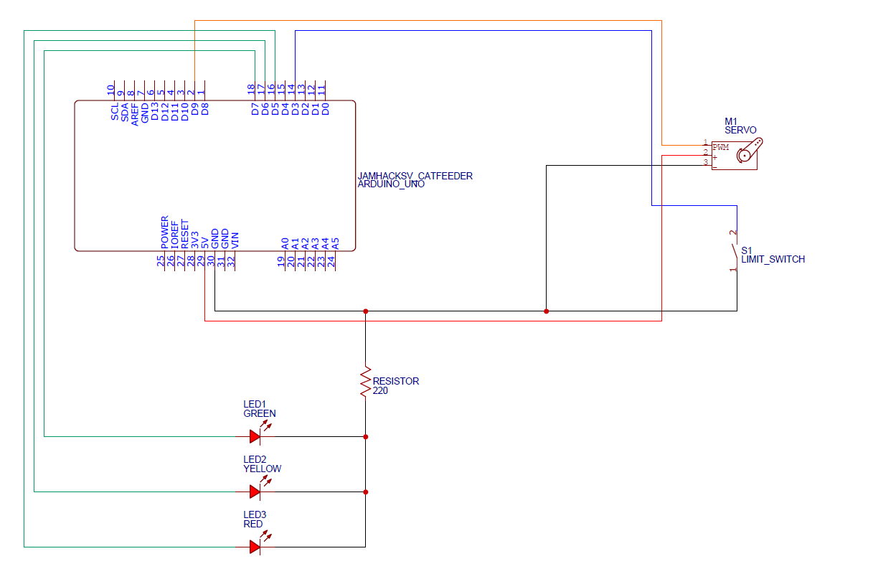
Arduino
The Arduino code is written in CPP and loops the following
checkFoodLevel() // reflected by the red LED
// sends signal to Python to email
ifSignalForFeedingTime()
// reflected by the yellow LED
dropFood()
// rotates servo to open the door
// reflected by the green LED
The circuit is quite simple, and consists of a Arduino Uno, servo, three LEDs, and one 220 Ω resistor.

Slide 8
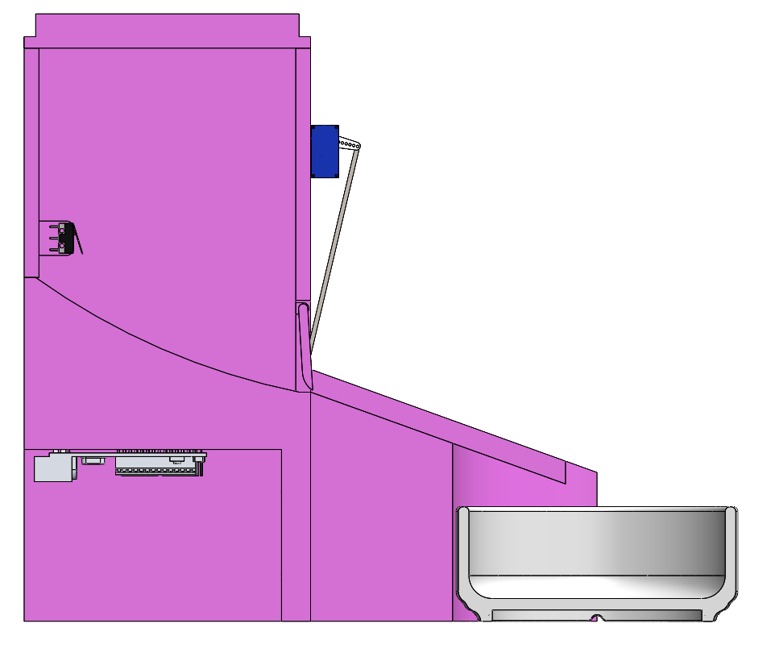
Design
The Cat Feeder was designed around two main features. The electronic components, and the food bowl.
The design was to be kept simple for fast printing.
Food Tank
Food Slope
Hidden
Electronics
Bowl

Slide 9
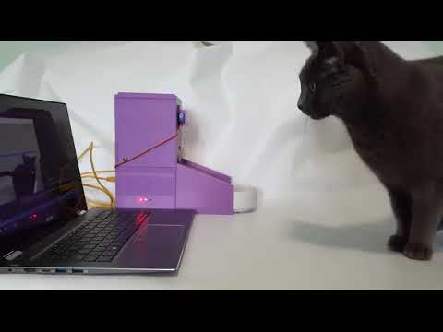
Cat Feeder at Work

Slide 10
Q&A
Visit CatFeeder.tk for Technical Details

Slide 11
Who are we?
Owen and Janik are both technology enthusiast, who enjoy combining hardware and software to make cool things.
We had a lot of fun with this project, as it was our first hackathon, and can’t wait to hear what you think!
Owen and Janik

Slide 12
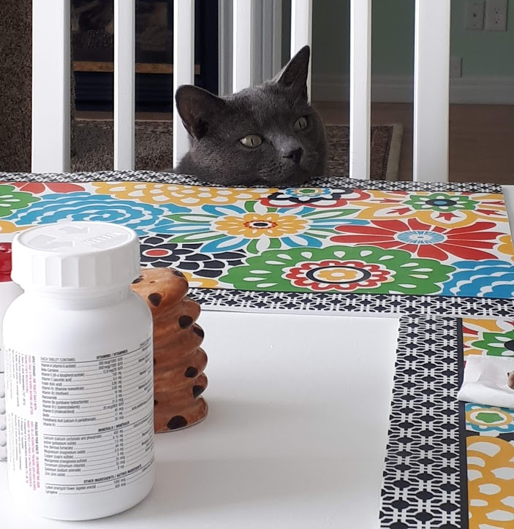
Why? (cont.)
In North America, obesity is the most common preventable health concern in cats. Approximately 30-35% of the feline population is obese.
To prevent Masha from starving or becoming obese, the feeder is programmed to only feed the cat once an hour, only three certain hours of the day.
Overweight Norm in NA

